Slide 1
Smart Cities – Group 12
Alex Blandón, Jonas Levi Doll, Max Concellon Marimon, Michelangelo Inzerilli
Notes:
Hello, we‘re Group 12 and we were wondering:

Slide 2





How can we be smarter,
at managing the energy of our buildings?
Notes:
Homeowners traditionally relied on stable electricity prices with rigid contracts. Now, as gas boilers are replaced by heat pumps, EVs grow in popularity, and PV panels become mainstream, residential electricity bills are rising—but these changes also create opportunities to cut costs and increase self-sufficiency. The key question for households: How can we manage building energy more intelligently?

Slide 3





Smart Buildings and Communities
Financial Impact
NPV Difference (20 y)
Energy Supply Costs per kWh
Occupant Comfort
Energy Deficit
Building Min. Tº
DHW Top Layer Min. Tº
Environmental Impact
CO₂ Emissions
Direct Embedded emissions Grid Vs PV (No credit)
Focus Stakeholders
  House owners
  (Consumers)
DSO - Distribution System Operator
(Supplier)
Notes:
To smartly manage energy in buildings and communities, we developed a controller using key KPIs: NPV over 20 years and energy supply costs for financial impact, a custom comfort indicator (energy deficit, minimum building temperature, and DHW top layer temperature), and embedded grid CO₂ emissions (excluding emissions avoided by exported PV power). These KPIs were selected based on stakeholder priorities—primarily homeowners and the DSO.

Slide 4
E & C – Levels Analysis
Invidual strategies and combined controllers
for each Technology

Slide 5









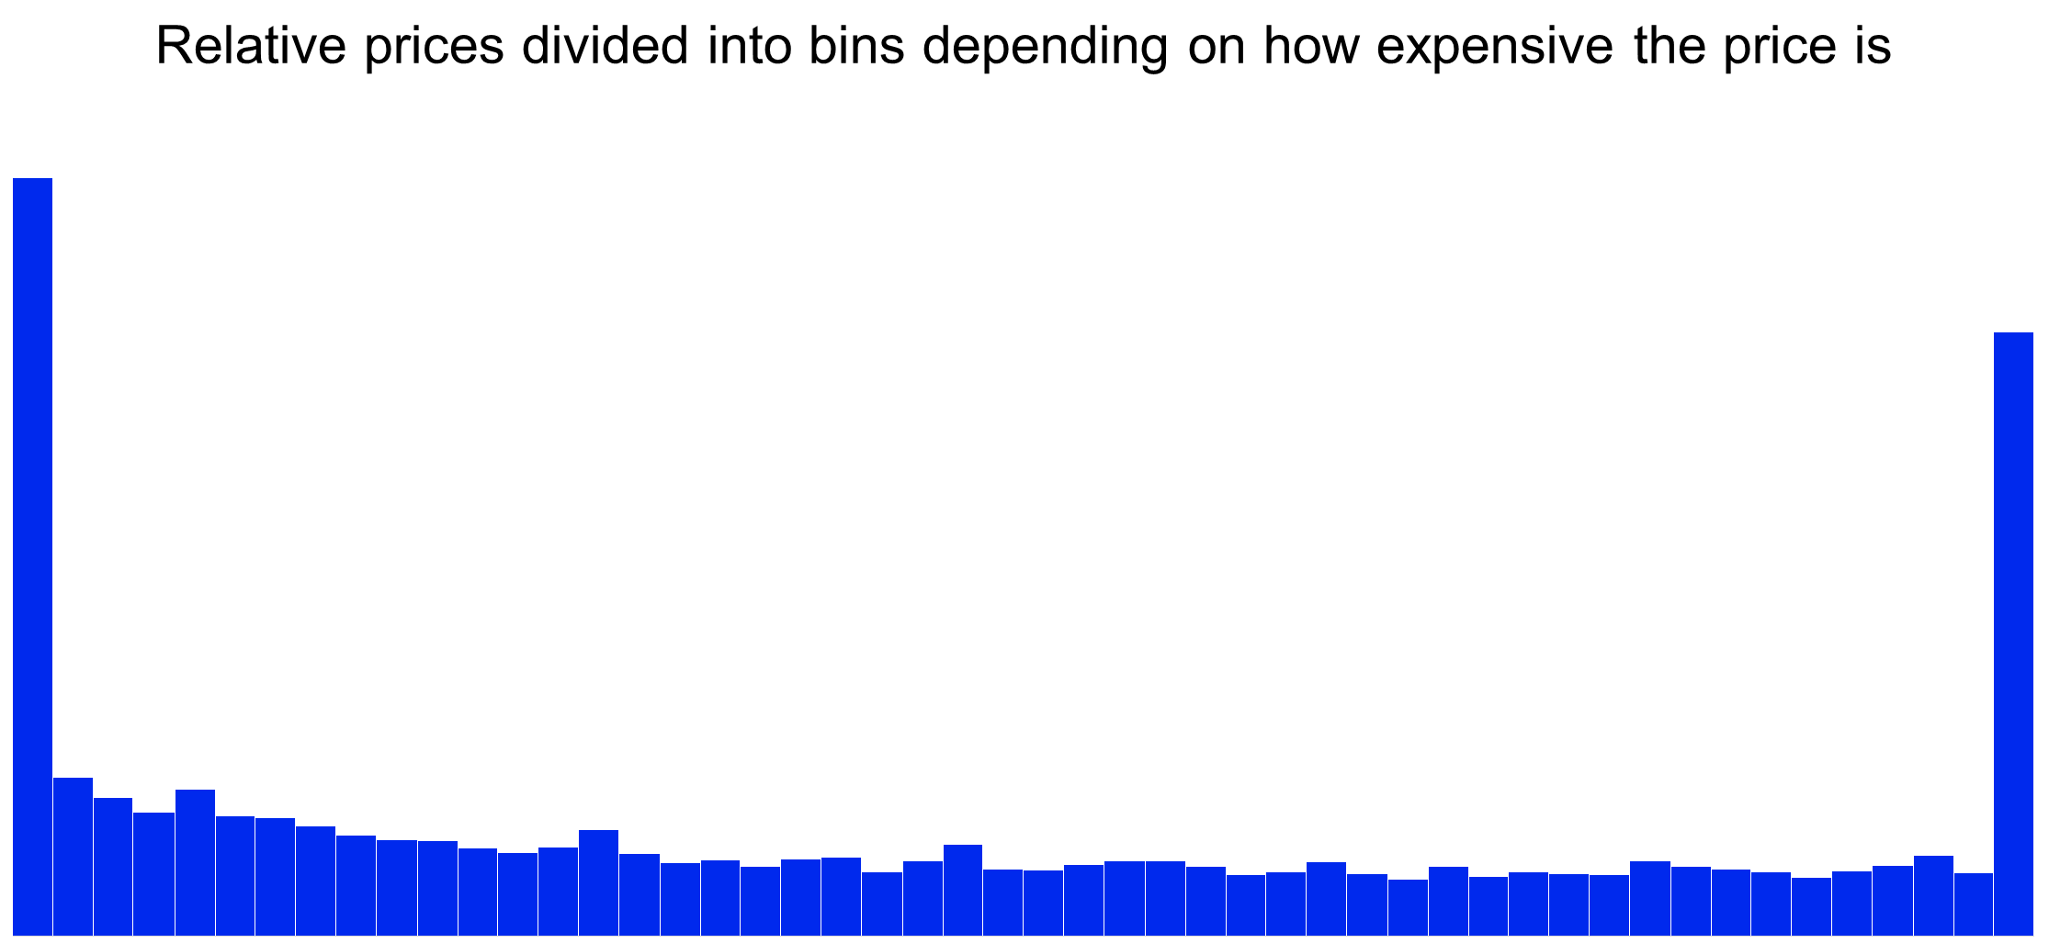
Optimising House 1012:
Heat Pump
1.
Peak Shaving
Combined Controller
2.
Self Consumption
NPV:
+5.2 %
CO2:
- 4.8 %
Relative prices divided into bins depending on how expensive the price is
3.
Comfort:
+15.0 %
Price Arbitrage
0
1

Slide 6
Optimising House 1012:
Heat Pump
1.
Peak Shaving
Combined Controller
2.
Self Consumption
Comfort:
+15 %
CO2:
- 4.8 %
Relative prices divided into bins depending on how expensive the price is
3.
NPV:
+5.2 %
Price Arbitrage
0
1
Notes:
In the case of the heat pump, peak shaving is most effective during periods of high electrical consumption, while self-consumption is activated when PV production peaks. Our price arbitrage strategy, based on detailed price analysis, only reduces the heating rate when the relative price is zero. While price arbitrage and peak shaving help lower energy supply costs and improve NPV, they also increase energy deficits and reduce occupant comfort. However, by integrating self-consumption into a combined controller, we add an energy buffer that significantly enhances comfort.
When implementing the final combined controller, we prioritize peak shaving first, followed by self-consumption, and finally price arbitrage—reflecting both their strategic importance and their placement within the heat pump system. As a result, this approach increases NPV by 5%, improves occupant comfort by 15%, and reduces environmental impact by 5%.

Slide 7

Optimising House 1012:
Battery
Self Consumption
Price Arbitrage
Peak Shaving
NPV:
+2.3 %
CO2:
- 3.6 %
Without subsidies economically not viable!
Energy supply cost:
-10.1 %

Slide 8


Optimising House 1001:
EV
1.
Peak Shaving
-15%
2.
Combined Controller EV + HP
Self Consumption
+40%
3.
Price Arbitrage
-6%

Slide 9




Smart Controller Deployment:
HP + EV
PA
PA
PA
PA
PA
PA
Costs per kWh
-20.5%
Full Charge Rate
X 2
NPV:
+4.9 %
CO2:
- 12 %
House 1012
Comfort:
+20.3 %
House 1001

Slide 10
A – level analysis
Community energy system with smart control for every technology

Slide 11








Energy Community
12 Homes Vs. Community
Before Smart Control
Shared Excess PV Generation
66% Larger Storage Tank
  More Thermal Inertia
Individual Houses
Uncoordinated SC
Smaller DHW Tank (Less Thermal Inertia)
Energy Community
Energy supply costs:
-29.5 %
Comfort:
-3,78 %
(Within limits)
Baseline Community Vs Independent Homes
Higher SC
+35.6%
Lower Peak P Import
-23,34%
CO2:
- 15.5%
NPV:
+8.9 %
Notes:
A collection of independent households has several issues, such as uncoordinated self-consumption, and smaller DHW tanks distributed across all houses of the neighborhood. When implementing an energy community, even before smart controls we can have a better utilization of excess PV, and having a larger centralized storage tank provides more thermal inertia to the community. This means that even before applying smart controls, Energy communities have 35.6% higher SC than a collection of independent homes, and 23,3% lower Peak P imports. This ultimately leads to a reduction in costs of 30% and 9% higher NPV, a slight reduction in comfort of 3,7%, while still within hard limits of comfort, and CO2 emissions are reduced by 15.5%, meaning that Energy communities present a significant improvement over a collection of individual houses.

Slide 12



Energy Community
Smart Homes vs.
Smart Community
Smart Community
Building and DHW demand satisfied
+53% SC increase
Smart Control; Margin of Improvement
Larger Marginal Improvement From Making Independent Houses Smart
Better Absolute Values of KPIs in E Community
Notes:
Whilst Energy communities present a massive improvement by themselves, we can still go a step farther and implement smart controls to improve their performance across several metrics. In our case, the final smart community focused on HP control, given that EV and Battery controls yielded less positive results, and combining technologies presented several challenges due to the interaction between the controls. With the best performing HP control, a smart energy community can satisfy the minimum building and DHW demands of residents, whilst we could increase SC by 53%.
When comparing the improvements of making an energy community smart against making a collection of homes smart, we can see that the marginal gains of making individual homes smart were higher than for making a community smart. As seen in this graph with the grey bar, smart homes have a largerg margin of improvement over the baseline than smart community for C=2 emissions, the comfort level, average electricity costs and the NPV, and only for the peak P reduction the energy community yields a larger margin of improvement. Ultimately, this whilst there is a larger marginal improvement from making independenr houses smart, you still have better absolute values of KPi's in an Energy community.

Slide 13
Results and conclusion
Recommendations and future work on the smart city controllers

Slide 14



Results and Conclusions
Technology Comparison
Heat Pump > EV Control > Battery
Difficult Cross-Technology Integration (Correlated effects)
Uncontrolled Energy Community > Smart Collection of Households
DSO Perspective
Smart Community Give Lower Margin of Improvement Than Smart Houses
Grid Purchases
Peak Import
and PV Export
Smart Households
Energy Community

Slide 16
Thank you

Slide 17
Backup Slides

Slide 18
The Price Analysis – Price Arbitrage for the HP
Thresholds based on relative price distribution
Trade-off between energy consumption and load shifting
0
1

Slide 19




Individual controllers
Heat Pump
Strategy | SC(DHW+SH)_400l | PA(DHW+SH)_200l | PS(APP_EV)_400l
Energy Deficit [kWh] | 45.9 | 61.1 | 57.8
CO2 Emissions [kg] | 4053 | 3874 | 4159
Building Min. T [Cº] | 20.5 | 20 | 20.5
DHW top layer Min. T [Cº] | 50.5 | 47.5 | 47.8
Peak Power [kW] | 6609 | 6425 | 5246
NPV difference [SEK] | +5 758 | +28 604 | +27 904
Self-Consumption
Price Arbitrage
Peak Shaving
Tank size – 400 l.
Additional inertia for SC "dumping" and PS comfort
Little effect on PA

Slide 20
Combined Controller:
Heat Pump
Self-Consumption
Price Arbitrage
Peak Shaving
Tank size: 400 L (House 1012)
Additional inertia for SC "dumping" and PS comfort
Little effect on PA

Slide 21

Combined controller
EVs
NPV:
-20 %
Self-Consumption
Price Arbitrage
Peak Shaving
+39.1% SC
-10.6% SEK/kWh
-14% Peak P
Comfort:
+20 %
CO2:
-10 %

Slide 22
Individual controllers
Battery
Strategy | SC | PA | PS
Energy Deficit [kWh] | 56.8 | 56.8 | 56.9
CO2 Emissions [kg] | 3951 | 4165 | 3997
Self consumption [%] | 47.7 | 40.2 | 38.4
Annual discharge [kWh] | 751 | 361 | 77.4
Peak Power [kW] | 6606 | 6606 | 4764
NPV difference [SEK] | -38539 | -39946 | -9013
Self-Consumption
Price Arbitrage
Peak Shaving

Slide 23

Combined Controller
Battery
Self-Consumption
Price Arbitrage
Peak Shaving

Slide 24





Combined Strategy
Heat Pump
Appliances and EV load
Net self production
Relative el. price
12 Building Average
+7.7% SC Increase
-2.2% Energy Consumption
-28.4% Peak P
Quantitative Results analysis (average price, energy supply costs, self consumption, energy deficit, HP switch on times, NPV value)
Peak Shaving
Self Consumption
Price Arbitrage
PA+PS PA+SC SC+PS PA+PS+SC
Comfort
Cost Savings
Energy deficit
-23.9%
Building Min. Tº
20.4 Cº (1.5% increase)
DHW Min. Tº
44.5 Cº (1% increase)
NPV Difference
386 798
Costs per kWh
-10.3%
CO2 emissions
-5.2 %

Slide 25
Combined Strategy
Combined Controllers
Peak Shaving
Self Consumption
Price Arbitrage
+3.8% SC Increase
-3.7% Energy Consumption
-4.9% Peak Power
Best Controller; EV + HP control
Bad Impact of BESS without subsidies
Energy deficit
-23.7%
Building Min. Tº
20 Cº (2% decrease)
DHW Min. Tº
47.7 Cº (1.4% decrease)
NPV Difference
410 276
Costs per kWh
-20.5%
CO2 emissions
-12 %

Slide 26
Energy Community
Heat Pump
Self-Consumption
1.78 SEK/kWh
Price Arbitrage
1.81 SEK/kWh
Peak Shaving
-22% Peak P
-1% E Consumption
20.5 / 57.3 Cº
+7% SC increase
1.71 SEK/kWh (-7%)
Combined Control
-16% Peak P
= E Consumption
20.5 / 57.4 Cº
+53% SC increase
1.71 SEK/kWh (-7%)
Comparison Vs. Baseline Energy Community
Moderate Improvements of SC and PA
Large Improvement of PS
Low Impact on Comfort

Slide 27

Energy Community
Heat Pump
Strategy | SC(DHW+SH) | PA(DHW+SH) | PS(APP_EV) | SC+PA+PS
Energy Deficit [kWh] | 826 | 834 | 833 | 828
CO2 Emissions [ton] | 31.9 | 33 | 32.7 | 32.4
Building Min. T [Cº] | 20.6 | 20.5 | 20.5 | 20.5
DHW top layer Min. T [Cº] | 57.4 (52.4) | 59.5 (54.4) | 57.3 (52.3) | 57.4 (52.4)
Peak Power [MW] | 40 | 39.8 | 31.9 | 34.4
NPV difference [kSEK] | 62.8 | 40 | 172.6 | 142.8
Self-Consumption
Price Arbitrage
Peak Shaving
Combined Control

Slide 28
Energy Community
Baseline Vs. Community
Before Smart Control
Shared PV Self-Consumption
More Thermal Inertia
  66% Larger Tank
  Larger Building (Unrealistic)
Individual Houses
Uncoordinated SC
Small Buildings/DHW Tanks (Less Thermal Inertia)
Higher Self-Consumption
+35.6% Increase
Strategy (No control) | 12 Independent Households (Baseline) | Energy Community (Baseline)
Energy Deficit [kWh] | 637 | 829
CO2 Emissions [ton] | 39.4 | 33.3
Building Min. T [Cº] | 20.4 | 21.1
DHW top layer Min. T [Cº] | 48.4 | 59.5 (54.4)
Peak Power [MW] | 53.64 | 41.12
Average cost of electricity [SEK/kWh consumed] | 2.61 | 1.84

Slide 29
Energy Community
Smart Homes Vs. Smart Community
Smart Energy Community
Shared PV Self-Consumption
More Thermal Inertia
  66% Larger Tank
  Larger Building (Unrealistic)
Individual Houses (Smart Control)
Uncoordinated SC
Small Buildings/DHW Tanks (Less Thermal Intertia)
NPV
+5%
XX
+X% Increase
Strategy | 12 Independent Households (HP+EV) | Energy Community (HP)
Energy Deficit [%] | -23.7% | -0.1%
CO2 Emissions [%] | -12.0% | -2.5%
Building Min. T [Cº] | 20 | 20.5
DHW top layer Min. T [Cº] | 47.7 | 57.4
Peak Power [%] | -4.9% | -16.4%
Average cost of electricity in Y1 [SEK/kWh consumed] | 2.08 | 1.71

